Slide 1
Design Patterns
Unit 04
The Dynamic and Static Aspects of a System

Slide 2
Objectives
In this lesson, you will learn to:
Identify the dynamic and static aspects of a system
Draw collaboration diagrams
Draw sequence diagrams
Draw statechart diagrams
Understand activity diagrams
Identify software components of a system
Draw component diagrams
Identify nodes in a system
Draw deployment diagrams

Slide 3
Dynamic and Static Aspects of a System
A system comprises of processes
Processes are realizations of methods or behaviors
Predefined methods constitute the static aspect of the system
Methods, when applied in a real-life scenario to accomplish a particular task, constitute the dynamic aspect of the system
The behavioral view depicts the dynamic aspect of the software system model

Slide 4
Types of Diagrams
Collaboration Diagrams
Sequence Diagrams
Statechart Diagrams
Activity Diagrams

Slide 5
Types of Diagrams (Contd.)
Collaboration Diagrams - Represent the interaction between classes and their associations
Sequence Diagrams - Describe the interaction between classes and their associations
Statechart Diagrams
  Describe the behavior of a class when accessed by external processes or entities
  Depict the states and responses of a class while performing an action

Slide 6
Types of Diagrams (Contd.)
Activity Diagrams
  Depict the activities of a class
  Describe the behavior of a class when accessed by internal processes or entities

Slide 7
Collaboration Diagrams
Are used to:
  Understand the messages that are exchanged between classes
  Depict relationships between classes and their associations

Slide 8
Collaboration Diagrams (Contd.)
Diagrammatic Conventions for Drawing Collaboration Diagrams
<Association Role>
<Sender Class>
<Receiver Class>

Slide 9
Collaboration Diagrams (Contd.)
Enter Bill Details
Clerk
Calculate Total Amount
Print Bill
Clerk

Slide 10
Collaboration Diagrams (Contd.)
List of classes, behaviors, and attributes
Class
Behavior
BillDetailAcceptor
ValidateBillDetail()
Clerk
EnterBillDetail()
Product
TotalAmountCalculator
calculateTotalAmount()
BillPrinter
printBill()
Bill
addProductDetail(), editProductDetail(), deleteProductDetail().

Slide 11
Collaboration Diagrams (Contd.)
Association Roles
  Specifies the role that a class plays in a collaboration of classes
  Similar to the defined behaviors of the class
  The association roles are:
    Enters Bill Details
    Notifies Bill Details
    Calculate Total Amount
    Print Bill

Slide 12
Collaboration Diagrams (Contd.)
Message Flows
  Classes exchange messages by following defined association roles. The message flows are:
    Enter Bill Details flow from the Clerk to the BillDetailAcceptor
    Validate Bill Details flow from the BillDetailAcceptor to the TotalAmountCalculator
    Calculate Total Amount flow from the TotalAmountCalculator to the BillPrinter
    Print Bill flow from the BillPrinter to the Clerk.

Slide 13
Collaboration Diagrams (Contd.)
Collaboration diagram
BillDetailAcceptor
Enter Bill Details
Clerk
Validate Bill Details
TotalAmountCalculator
Calculate Total Amount
BillPrinter
Print Bill
Clerk

Slide 14
Problem Statement
In the internal job postings process, the HR head of the region where a vacancy exists informs the employees of that region and other regional HR heads about the vacancy. The other regional HR heads inform employees by putting up a notice with the vacancy information.
Draw a collaboration diagram.

Slide 15
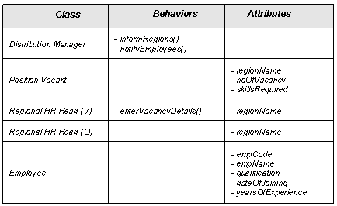
Solution
List of classes, behaviors, and attributes

Slide 16
Solution (Contd.)
Association Roles
  The association roles are:
    Enters vacancy details
    Notifies vacancy details
    Informs vacancy details

Slide 17
Solution (Contd.)
Message Flows
  The message flows are:
  Vacancy details flow from the Regional HR Head (V) to the Distribution Manager
  Vacancy details flow from the Distribution Manager to the Employee
  Vacancy details flow from the Distribution Manager to the Regional HR Head (O)

Slide 18
Solution (Contd.)
Collaboration Diagram
Enters
vacancy details
Distribution Manager
Notifies vacancy
details
RHR(V)
EMP
Informs vacancy
details
RHR(O)

Slide 19
Sequence Diagrams
Show interactions between classes arranged in a time sequence
Interactions are the message exchanges that take place between classes to accomplish a specific purpose
Interactions are associated with use cases and are depicted by scenarios

Slide 20
Sequence Diagrams (Contd.)
In the billing system, the interactions would be in the following sequence:
  The Clerk class interacts with the BillDetailAcceptor class
  The BillDetailAcceptor class interacts with the TotalAmountCalculator class
  The TotalAmountCalculator class interacts with the BillPrinter class
  The BillPrinter class interacts with the Clerk class

Slide 21
Diagrammatic Conventions for Drawing
Sequence Diagrams
  The Classes are represented by rectangles
<Class Name>

Slide 22
Diagrammatic Conventions for Drawing
Sequence Diagrams(Contd.)
  Interactions are represented by dotted lines
  Labeled horizontal arrows depict the direction of message flows between classes
<Class Name>
<Class Name>
1: <message>

Slide 23
Sequence Diagram
BillDetailAcceptor
TotalAmountCalculator
BillPrinter
Clerk
Clerk
1. Enter Bill Details
2. Validate Bill Details
3. Calculate Total
Amount
4. Print Bill

Slide 24
Statechart Diagrams
Statechart diagrams
  Lie within the behavioral view of a system
  Are drawn only for those classes, which have very high dynamic behavior within the context of the system
  Represent various entity states and transitions
  Describe the behavior of objects when an external entity initiates a task to be performed by the object

Slide 25
Statechart Diagrams (Contd.)
  Depicts a situation during the life of an object in which the object:
    satisfies certain conditions
    performs a certain activity
    waits for an event to occur
Transitions
  Describe the relationships between various states of an object in a system
  Are used to model the relationships between various states of an object

Slide 26
Statechart Diagrams Contd.)
Consider the example of the billing system. The various states of the bill are:
  Bill empty
  Bill with items
  Bill with total amount
  Bill closed
  Bill printed

Slide 27
Diagrammatic Conventions for Drawing Statechart Diagrams
States are represented by rectangles with rounded corners
<State Name>

Slide 28
Diagrammatic Conventions for Drawing Statechart Diagrams(Contd.)
Transitions are represented by arrows between the states
All transitions must be labeled
<Transition Name>
<State Name>
<State Name>

Slide 29
Example For Statechart Diagram
Bill Empty
Bill details entered
Bill with Items
Total amount calculated
Bill with Total Amount
Bill closed
Bill closed
Bill printed
Bill printed

Slide 30
Activity Diagrams
Are similar to statechart diagrams and use similar diagrammatic conventions
Action states represent the state of execution of atomic actions or operations within a system
Every activity can be divided into many noninterruptible actions called atomic actions
Action flows represent the association between various action states of an object
Object flows describe the association between action states and objects

Slide 31
Diagrammatic Conventions for Drawing Activity Diagrams
Action states are represented as shown:
Action flows are represented as solid paths
<Action State>
Action flows
<Action State>
<Action State>

Slide 32
Diagrammatic Conventions for Drawing Activity Diagrams(Contd.)
Object flows are represented as dotted lines:
Object
Flow
<Action State>
Object
<Action State>

Slide 33
Activity Diagram
The diagram shows the various bill objects manipulated by the activities
Bill
Bill details entered
Total amount calculated
Bill closed
Bill printed

Slide 34
Implementation View of a System
  Depicts various aspects of software system implementation
    For example:
      the source code structure
      the run-time implementation structure
      configuration management of software releases

Slide 35
Implementation View of a System (Contd.)
Component is a class or a group of classes that help in performing a well-defined, real-life task, independent of its surrounding
Component diagrams are used to represent the implementation view of a system

Slide 36
Diagrammatic Conventions for Drawing
Component Diagrams
Components are represented as shown:
Two or more components are depicted in a component diagram, as shown:
<Component>
<Component one>
<Component two>

Slide 37
Component Diagram
The diagram given below shows one of the components of the billing system
Bill Detail
Acceptor
component

Slide 38
Problem Statement
In the internal job postings process, the HR head of region where a vacancy exists informs the employees of that region and other regional HR heads. The other regional HR heads inform employees by putting up a notice with the vacancy information.
Draw the component diagram.

Slide 39
Solution
List of classes, behaviors, and attributes:

Slide 40
Solution: (Contd.)
Component Diagram
  The distribution manager class maps to a component
Distribution Manager
component

Slide 41
Environment View of a System
Environment view:
  Depicts the physical distribution of various components used in the system
  Is also known as the deployment view
  Depicts the nodes that form a part of the physical hardware requirement for the deployment of the system
  Includes the nodes that represent a system’s hardware requirement or design of the network in which the system will be deployed

Slide 42
Diagrammatic Conventions for Drawing Deployment Diagrams
Nodes are represented as three-dimensional cubes
<Node>

Slide 43
Problem Statement
In the internal job postings process, the HR head of a region where a vacancy exists informs the employees of that region and other regional HR heads. The other regional HR heads inform employees by putting up a notice with the vacancy information.
Draw the deployment diagram.

Slide 44
Solution
Various nodes would be:
  The user node, which the user (HR head of the region where the vacancy exists) uses for entering the vacancy details
  The server node that hosts the application software
  The database server node that hosts the database

Slide 45
Deployment Diagram for the HR department
User Node
Application Server Node
Database Server Node

Slide 46
Example for Deployment Diagram
Consider the billing system example. The nodes identified are the Application Server Node, the Database Server Node, the User Node, and the Printer Node
User Node
Application Server Node
Database Server Node
Printer Node

Slide 47
Problem Statement (Personal)
In response to the vacancy information, employees from various regions send their applications to the HR head of the region where the vacancy exists.

Slide 48
Problem Statement (Personal)
Use the classes, their behaviors, and their attributes that you have identified for this part of the internal job postings process to:
  Identify association roles and message flows
  Draw the collaboration diagram

Slide 49
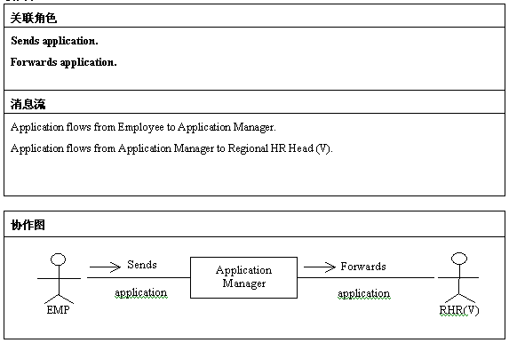
Solution

Slide 50
Problem Statement 2 (Personal)
In response to the vacancy information, employees from various regions send their applications to the HR head of the region where the vacancy exists.
Use the classes, their behaviors, and their attributes that you have identified for this part of the internal job postings process to:
  Identify various software components
  Draw the component diagram

Slide 51
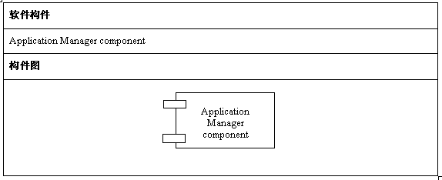
Solution

Slide 52
Problem Statement 3 (Personal)
In response to the vacancy information, employees from various regions send their applications to the HR head of the region where the vacancy exists.
Identify various nodes of the automated system for this part of the internal job postings process and draw the deployment diagram.

Slide 53
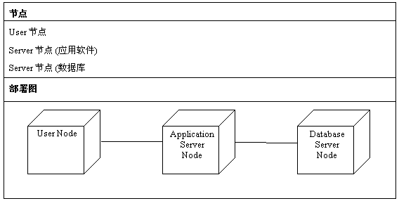
Solution

Slide 54
Summary
In this lesson, you learned that:
  Classes exchange messages by following defined association roles. Message exchanges are also called message flows.
  Collaboration diagrams are used to understand the messages that are exchanged between classes.
  A state depicts a situation during the life of an object in which the object satisfies certain conditions, performs certain activity, or waits for the event to occur.
  Transitions depict the relationships between various states of an object.

Slide 55
Summary (Contd.)
  Statechart diagrams explain the messages and attributes that the classes in a system must support to perform a purposeful behavior or functionality.
  A class or a group of classes, which help in performing a well-defined, real-life task, independent of its surrounding, is called a (software) component.

Slide 56
Summary (Contd.)
  Nodes depict the hardware components of a system on which software components are deployed and executed.

